Slide 1
Gender and Decolonisation
Addressing systemic racism and decolonising the international development sector
GADN Members’ Meeting:
Thursday 26 November 2020
Dr. Lata Narayanaswamy
Associate Professor in the Politics of Global Development
School of Politics and International Studies (POLIS)
University of Leeds, UK

Slide 2
Let’s start with some questions …
What does ’decolonising’ mean to you?
What do you think it might mean for your work as a gender and development practitioner?

Slide 3
White saviour complex

Slide 4
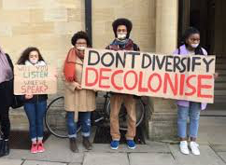
Why ‘decolonise’?

Slide 5
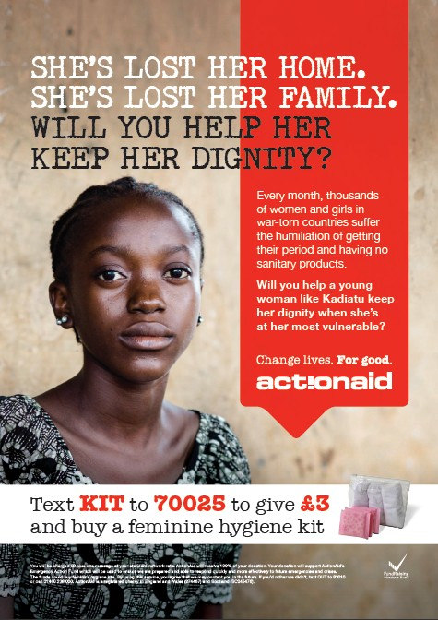
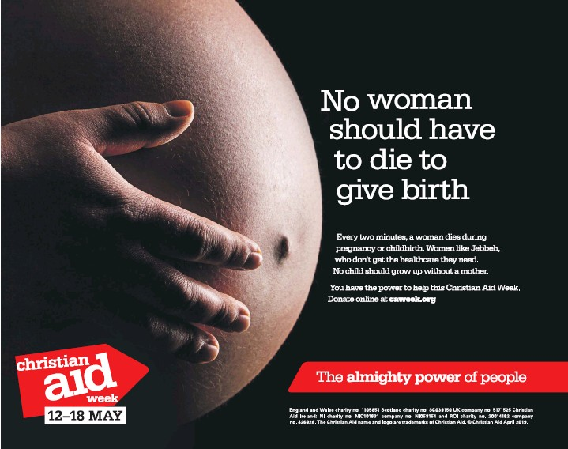
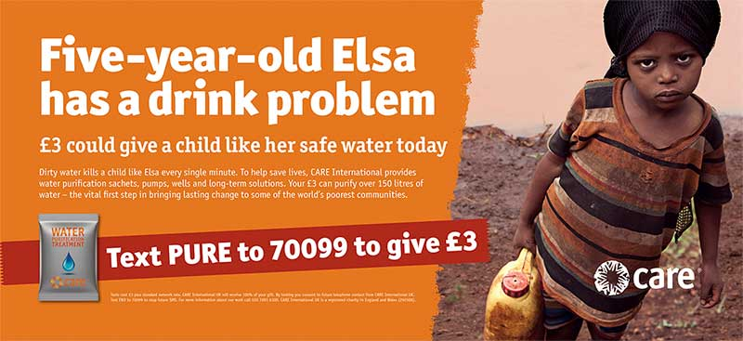
History’s winners …
The fact that we see through the eyes, and live by the rules of, history’s winners is not in itself surprising
The greatest feat of Western hegemony has been to convince us that the way we live is the natural course of things, that this is not one version of how the world might look but the ONLY, inevitable version

Slide 6
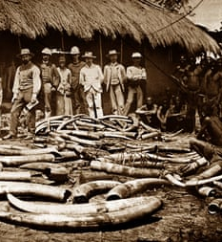
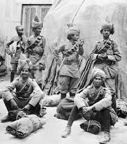
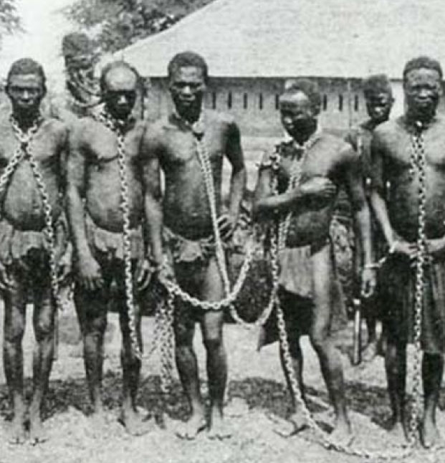
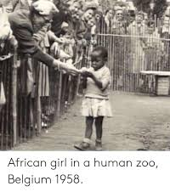
Confronting shared, global colonial legacies …
Colonialism is not just the story of the black and brown Other living in places distant from Europe and North America
Colonialism is OUR story
Post- versus de-colonial?

Slide 7
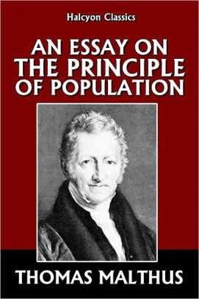
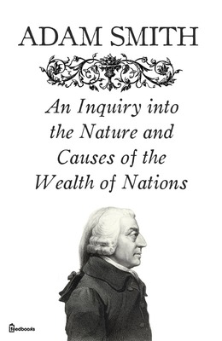
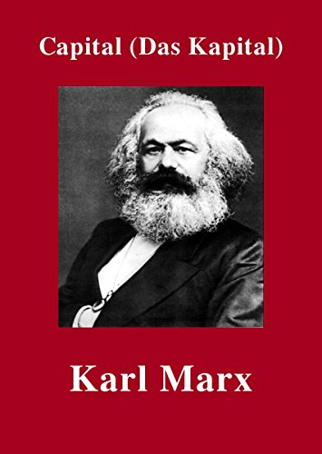
How we ‘know’ the world

Slide 8
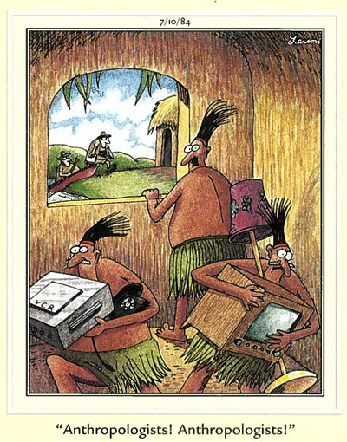
Dominant ‘ways of knowing’ development
Development as a hegemonic knowledge system
With a ‘discursive formation laid down in the period 1945–1955’, Escobar contends that development represents a particularised body of knowledge, a certain ‘way of knowing’.

Slide 9
Nagar’s ‘gender hegemony’
The funding agencies’ popularization of ‘gender’ (instead of ‘women’), of a focus on violence against women and HIV/AIDS (instead of infant mortality or price inflation of basic foods), and of microcredit programs (instead of women’s unions or land reforms) have enabled new political agendas to emerge. However, these shifts have also had the serious consequences of compromising radical politics. Not surprisingly, the interventions made by powerful NGOs have often ended up serving the interests of global capital …
Nagar (2006: 147)

Slide 10
SDGs and White, liberal feminism
The SDGs’ vision of change targets only the individual ‘woman’, an archetypal cisgender, straight, essentialised ‘Third World Woman’ who requires white saviourism to rescue her from her violent marriage by sticking a smartphone in her hand so that she may be ‘empowered’ …
Many facets of her life are ignored by the SDG framework: What about social and economic precarity, or improvements to employment conditions? What are the effects of the extractive practices of transnational corporations? What are the implications of institutionalised discrimination against minorities in her context/country/world? …
The ‘Third World Woman’ thus becomes the symbol of ‘marginality’ and ‘difference’ as compared to what liberal feminism centres as the norm: ‘the White Western Woman’.
‘The unbearable whiteness of international development: The SDGs and decolonial feminisms’, www.globalstudies.ugent.be/the-unbearable-whiteness-of-international-development/2/

Slide 11
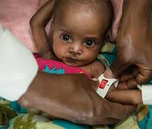
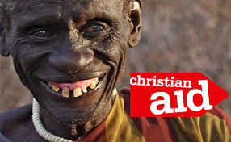
How we ‘know’ development ...
The language of our practice
English
Professionalised/academic/jargon
Universalisation of Western frameworks
Homogenising tendencies of development labels or categories
‘grassroots’; ‘local’ et al.

Slide 12
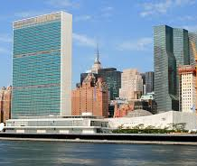
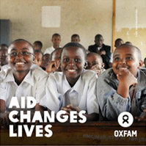
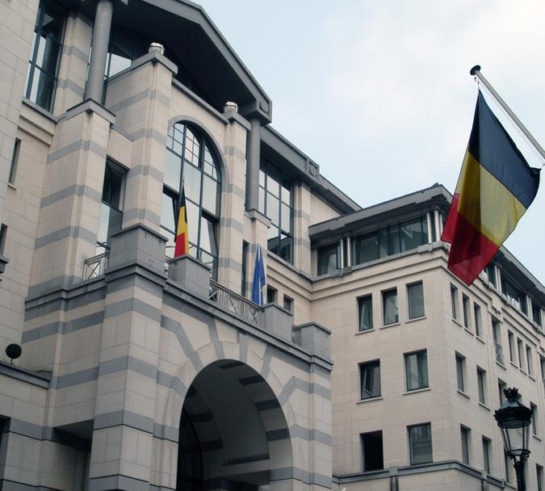
How we ‘know’ in development institutions ...
Institutional structures
Hierarchical (intersectional)
Professionalised
Competitive NOT collaborative
Privileges notions of expertise
The politics of development knowledge
Development as a ‘technical’ solution

Slide 13
What Matters Is Not Only What You Say but How You Say It …
‘... Legitimacy is achieved not just by alignment with dominant and/or depoliticised, technocratic discourses, but concretised through particularised ‘ways of knowing’ embodied in the written formats in which dominant knowledges are recorded, validated and proliferated’ (Narayanaswamy, 2019: 243)
How might (unequal) power relations affect your efforts to promote gender equality?

Slide 14
What’s in a word …
You don’t want Hindi of the academic kind of ... For example gender budgeting, there is no word for gender in Hindi ... There isn’t a word. We write gender, g-e-n-d-e-r like that. Otherwise people write ‘ling’ but ‘ling’ is actually sex. It’s not gender ... So, there is no – because when we got the Rajasthan book translated, they don’t know the difference between sex and gender, so they wrote ‘ling’ budgeting. So, we said, “ye ling budgeting nahin hai, ye gender budgeting hai [this is not sex budgeting, it’s gender budgeting]. They said, kya farq hai [what’s the difference?]. Aurton ka budget likh dete hai [we’ll call it woman’s budget]. Nahi ye aurton ke bhi budget nahi hai [No, this is also not a women’s budget]. Mahila budget likh den? [Shall we call it a woman’s budget? (Mahila being another word for ‘woman’ used in a range of development intervention contexts)]” So you do have these kinds of – and sometimes for issues like this, maybe it’s just good to use the English word [gender] written in that script, the Devanagari [Hindi] script.

Slide 15
Reflections on decolonising gender and development practice
Audience action?
Gender / Women?
Publications strategies
Resourcing the lifecycle of development interventions
Co-curation/production
Translation
Medium- to longer-term
Challenging N-S knowledge representations
POWER
What kind of life do people want?
Whose ideas about ‘sustainable development’ or ‘gender’ count?
Who gets to decide what ‘progress’ or ‘empowerment’ looks like?

Slide 16
Conclusion: Decolonising ‘Gender’?
Questions of power
What do we mean by ‘women’s voice’?
How do we listen?
What might this mean as we seek to ‘decolonise’ development?
Why might this matter?
And how can decolonisation be relevant to everyone?

